Slide 1
14.472 Public Finance II
Subsidizing Health Insurance for Low Income Adults: What Does It Do and What Does That Mean?
Amy Finkelstein
Fall 2024

Slide 2
Why Subsidize?
Adverse selection
Redistribution
NB: A distinct – and distinctive – issue of “affordability” with risk that is not proportional to income
Samaritan’s Dilemma
Medicaid: What Does It Do and What Does That Mean?

Slide 3
Health Insurance Coverage Over Time
Uninsured Rate, 1963–2022
25%
Creation of Medicare and Medicaid
20%
15%
Affordable Care Act / Medicaid Expansions
10%
2022:
28 million
5%
0
1960
1970
1980
1990
2000
2010
2020
Medicaid: What Does It Do and What Does That Mean?

Slide 4
Medicaid as Major Form of Redistribution
Medicaid provides public health insurance to low-income children, disabled, elderly, and some adults
Expanded in 2014 to adults up to 138% of federal poverty line
~11 million newly covered low-income adults (~1/3 of newly insured)
Medicaid spending is now ~$600 billion per year
Dwarfing next largest means-tested programs (SNAP, EITC: ~$70 billion each)
About the size of the national defense budget
Medicaid: What Does It Do and What Does That Mean?

Slide 5
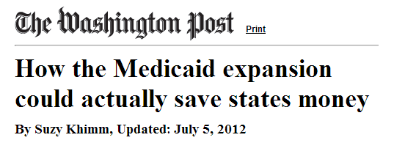
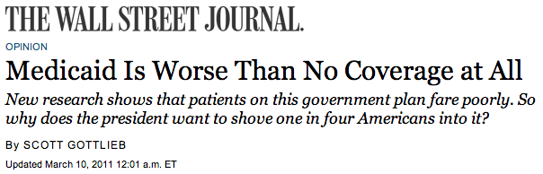

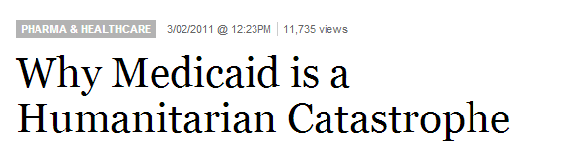

Helpful or Harmful: The Debate Over Medicaid

Slide 6
From Rhetoric to Research
Part I: Descriptive Evidence: Impacts of Medicaid
Randomized evaluation of extending access to Medicaid
Part II: Normative Interpretation: Value of Medicaid
Use simple economic theory to analyze descriptive results
Part III: Implications
For policy and for opportunities for much-needed future research
Medicaid: What Does It Do and What Does That Mean?

Slide 7
What Is Medicaid?
On paper extremely comprehensive
Covers most healthcare with minimal or no consumer-cost sharing or premiums
Concerns about low reimbursement rates to providers and resulting access issues
“The best insurance money can’t buy”
What are likely effects of Medicaid expansion on:
Health care use and health spending (“cost” of the program)
Health
Financial security (consumption smoothing)
Medicaid: What Does It Do and What Does That Mean?

Slide 8

Conjectured impact on health care spending
Basic economics: Expanding health insurance will increase health care spending (“Moral hazard”)
Insurance (by design) reduces the price individuals pay for their medical care
Economics 101: Demand increases as price decreases
Therefore newly insured will demand more medical care
But, other points of view…
Medicaid: What Does It Do and What Does That Mean?

Slide 9
Conjectured impact on health care spending
Health insurance will not increase health care spending
Nobody wants to go to the doctor
Health insurance will decrease health care spending
Reduce inappropriate and inefficient use of emergency rooms
Expanding Medicaid “means fewer folks are going to be going to the emergency room for treatable illnesses like asthma or strep throat”
- President Obama, 2013, urging states to expand Medicaid
Improve health and therefore reduce health care use
Medicaid: What Does It Do and What Does That Mean?

Slide 10

Possible benefits for health and financial security
Health
Improvements in health through increased utilization
Financial security
Consumption smoothing: reduced risk of large, out-of-pocket medical expenditures
Medicaid: What Does It Do and What Does That Mean?

Slide 11
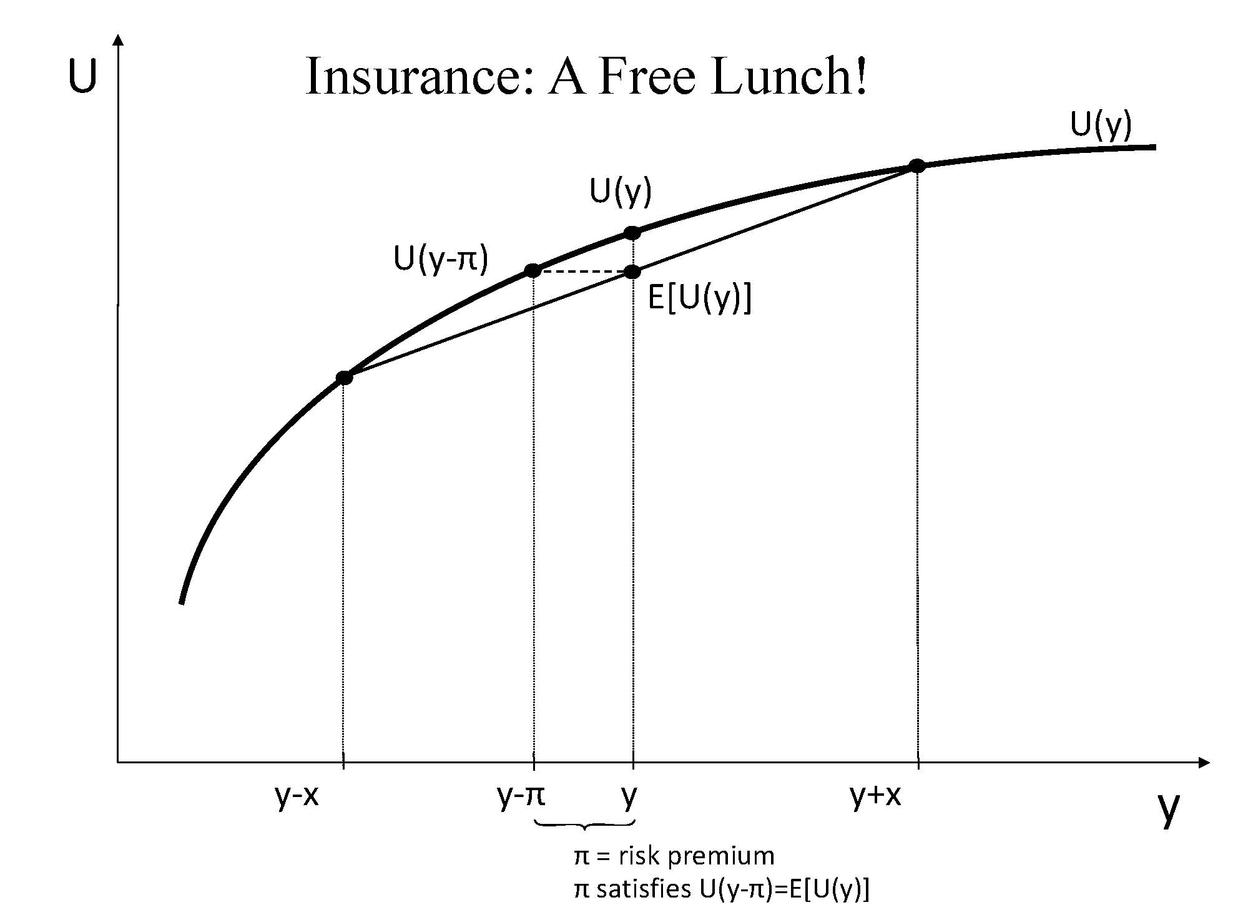
Insurance: A Free Lunch!
Medicaid: What Does It Do and What Does That Mean?

Slide 12
Additional ambiguity when it comes to Medicaid
Impacts of Medicaid on low-income uninsured may be much smaller than typical insurance impacts
Glass half full:
Low-income uninsured already consume subsidized medical care through public health clinics and uncompensated care
Glass half empty: Medicaid is not “good” insurance
Low reimbursement rates for providers makes it hard to access care
Evidence consistent with this:
“Secret shopper” / audit studies (very cool / under-appreciated)
Increased Medicaid rates increase access/use (Alexander and Schnell AEJ Applied, 2024)
Medicaid: What Does It Do and What Does That Mean?

Slide 13

How to Measure the Impact of Medicaid?
The Challenge: People with and without Medicaid differ in many ways
Hard to measure and control for
Can get perverse “findings” (e.g. Medicaid makes you sicker)
Randomly assign some uninsured individuals access to Medicaid
Solves causal inference problem
By construction, treatment and control groups on avg have same characteristics
Medicaid: What Does It Do and What Does That Mean?

Slide 14
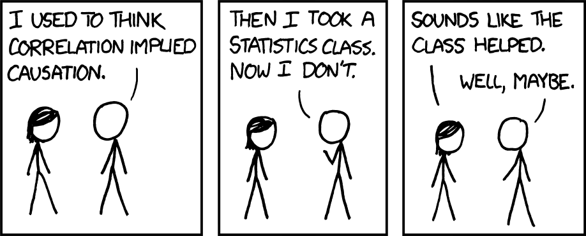
Correlation Vs. Causation
Source: XKCD, “Correlation,” https://xkcd.com/522
Medicaid: What Does It Do and What Does That Mean?

Slide 15
Beyond Causality: The Value of Randomization
Duflo: “Have the ability to surprise you”
Relatedly, can test for subtle, indirect effects (e.g. spillovers)
Design studies to answer the questions you want to answer (vs. where you can find variation)
Relatedly: Design to test theory and mechanisms
Gets us off our ass / forces us to do field work (which we should be doing even for non RCTs)
(See Alsan and Finkelstein, Milbank Quarterly 2021 for more discussion of these points)
Medicaid: What Does It Do and What Does That Mean?

Slide 16

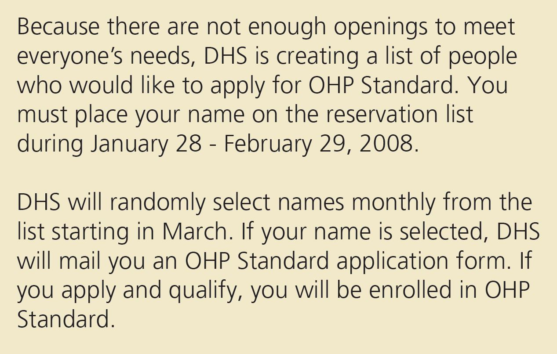
Oregon Health Insurance Experiment
Medicaid: What Does It Do and What Does That Mean?

Slide 17
Oregon Health Insurance Experiment
Oregon’s Medicaid expansion program covers those financially but not categorically eligible for Medicaid
Low-income (below 100% of federal poverty line), uninsured, able-bodied adults
Covers doctors, hospitals, drugs, mental health, etc. with no consumer cost sharing and low or no premiums
In 2008: Oregon had money to cover some but not all of those eligible… so chose to run a lottery for fairness
Asked interested individuals to sign up
Randomly assigned about 30,000 out of 75,000 low-income, uninsured adults ability to apply for Medicaid
Medicaid: What Does It Do and What Does That Mean?

Slide 18
Unprecedented Opportunity
To bring rigors of randomized trials to pressing domestic health policy question
First RCT to study the impact of covering the uninsured
Assembled a large research team
Co-PI: Katherine Baicker
Collaborators in academia, government, health care system…
Results, protocols and survey instruments, and data are publicly available: www.nber.org/oregon
Medicaid: What Does It Do and What Does That Mean?

Slide 19
Left No Data Stone Unturned…
Administrative data (e.g. hospital discharge records, emergency room visits, credit reports, earnings) (~75,000)
Mail surveys (sent to ~55,000 people)
Questions on health care use, financial strain, self-reported health and well-being
In-person interviews and physical health exams (~12,000)
Clinical measures: blood pressure, cholesterol, blood sugar, etc.
Detailed medication catalog
Medical history (e.g. dates of diagnoses)
Medicaid: What Does It Do and What Does That Mean?

Slide 20

Research: Always An Adventure
Medicaid: What Does It Do and What Does That Mean?

Slide 21
Empirical framework – very simple
Reduced form: Regress outcome on lottery assignment
IV: Regress outcome on insurance (Medicaid), instrumenting for insurance with lottery assignment (2SLS)
First stage 0.25
Think about exclusion restriction
Controls:
Need to control for anything correlated with probability of treatment
Household “size” / tickets
May improve power by controlling for baseline covariates
Medicaid: What Does It Do and What Does That Mean?

Slide 22
Empirical framework – some comments
Checking if randomization “worked”
Balance of covariates
Why needed?
Potential non-response bias in surveys
Examine: balance of response rate and covariates among responders
Took kit for imbalance:
Intensive follow up
Administrative data
Lee (2009) bounds (for lower response rate for treatment)
Assume anyone who responds as treatment would have responded as control
Lower bound for a positive treatment effect: drop controls with lowest outcome values until response rates are equalized.
Medicaid: What Does It Do and What Does That Mean?

Slide 23
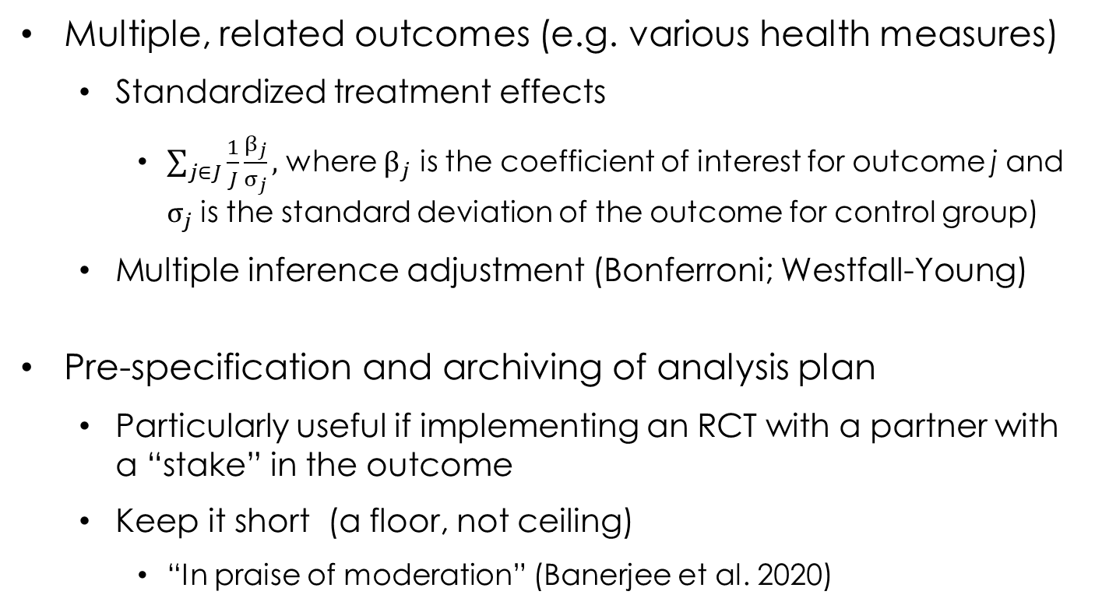
Empirical framework – some comments
Multiple, related outcomes (e.g. various health measures)
Standardized treatment effects
$\sum_{j∈J}{\frac{1}{J}\frac{β_{j}}{σ_{j}}},$ where $β_{j}$ is the coefficient of interest for outcome j and $σ_{j}$ is the standard deviation of the outcome for control group)
Multiple inference adjustment (Bonferroni; Westfall-Young)
Pre-specification and archiving of analysis plan
Particularly useful if implementing an RCT with a partner with a “stake” in the outcome
Keep it short (a floor, not ceiling)
“In praise of moderation” (Banerjee et al. 2020)
Medicaid: What Does It Do and What Does That Mean?

Slide 24
Results after 1-2 Years
Health care use
Financial well-being and security
Health
Medicaid: What Does It Do and What Does That Mean?

Slide 25
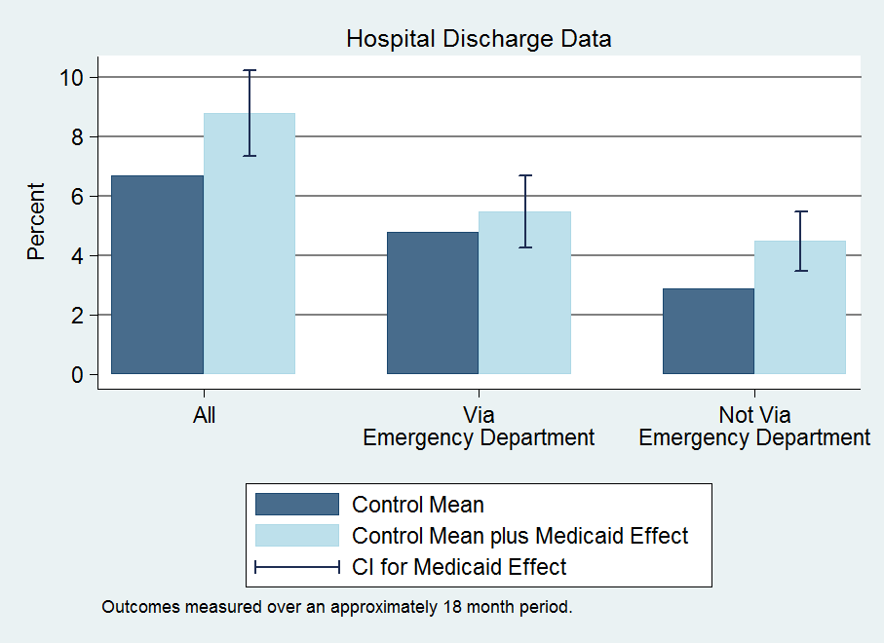
Medicaid Increases Hospital Admissions
Medicaid Increases Hospital Visits
Source: Quarterly Journal of Economics 2012
Medicaid: What Does It Do and What Does That Mean?

Slide 26
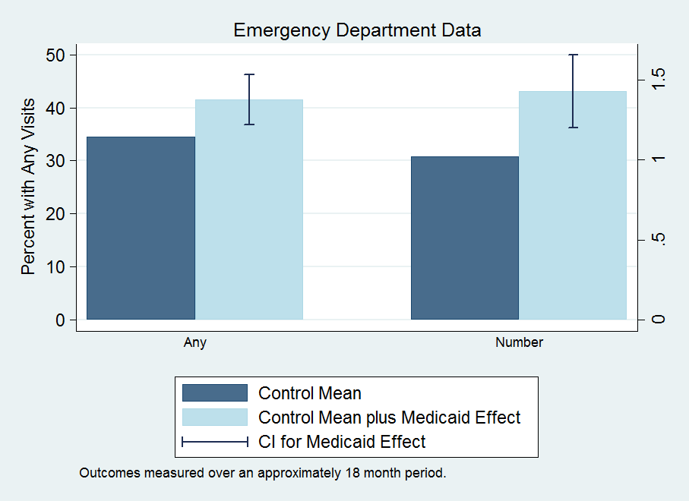
Medicaid Increases Emergency Room Visits
Source: Science 2014
Medicaid: What Does It Do and What Does That Mean?

Slide 27
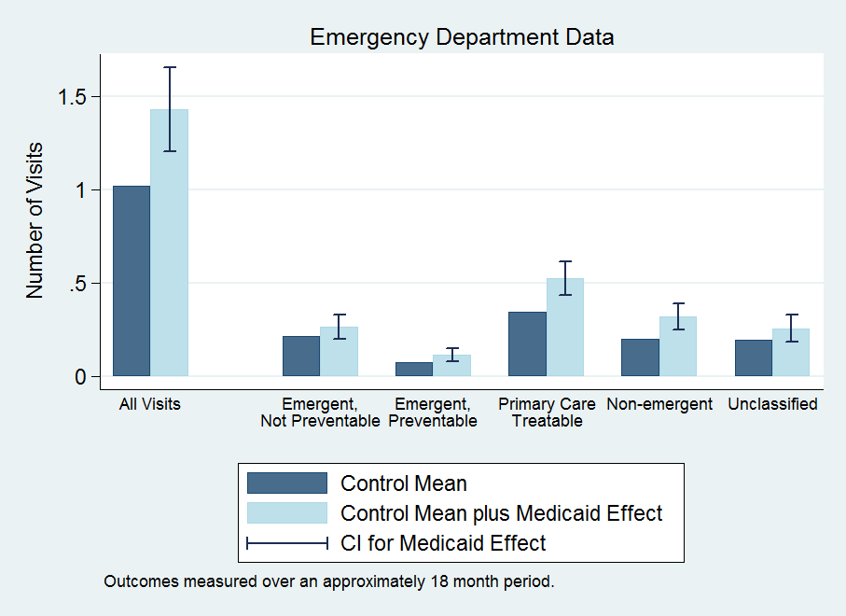
Medicaid Increases All Types of ER Visits
Source: Science 2014
Medicaid: What Does It Do and What Does That Mean?

Slide 28
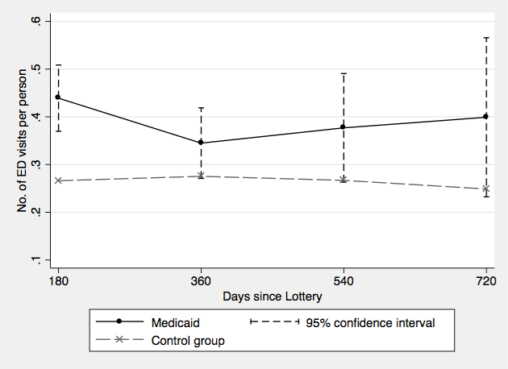
Increase in ER Use Steady Over First Two Years
Increase in ER Use Steady Over First Two Years
Source: new England journal of medicine 2016
Medicaid: What Does It Do and What Does That Mean?

Slide 29
(Aside – Value of Administrative Data)
We find increase in ER visits in ER discharge data, not in survey or interview data (Taubman et al. Science 2014). Why
Ability to look back over longer time horizons
More reporting error / noise in self-reports
Other advantages of administrative data
More detailed (diagnoses; detailed time patterns etc)
Much cheaper to collect
Avoid issues of non-response bias
Downside of administrative data:
If they don’t measure what you want to study
Medicaid: What Does It Do and What Does That Mean?

Slide 30
Is the Increase in ER Use a Puzzle?
Ex ante the effect could have gone either way:
Medicaid makes ER free → more use
Medicaid makes doctor visit free → more use of docs, ? use of ER
On net, we now know any “offset” from ER → doc does not dominate
Is this because Medicaid doesn’t increase doctor use?
Medicaid: What Does It Do and What Does That Mean?

Slide 31
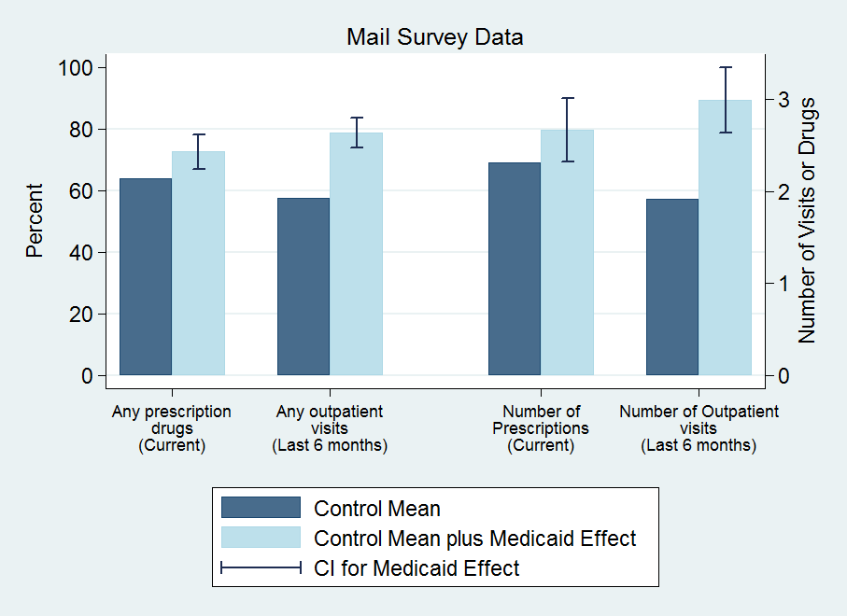
Medicaid Increases Primary Care
Source: Quarterly journal of economics 2012
Medicaid: What Does It Do and What Does That Mean?

Slide 32
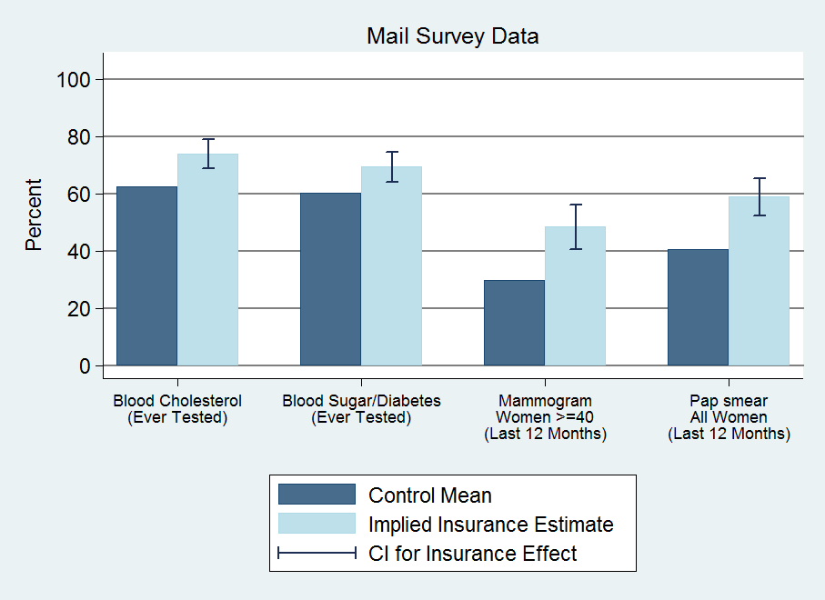
Medicaid Increases Preventive Care
Medicaid Increases Preventive Care
Source: Quarterly journal of economics 2012
Medicaid: What Does It Do and What Does That Mean?

Slide 33
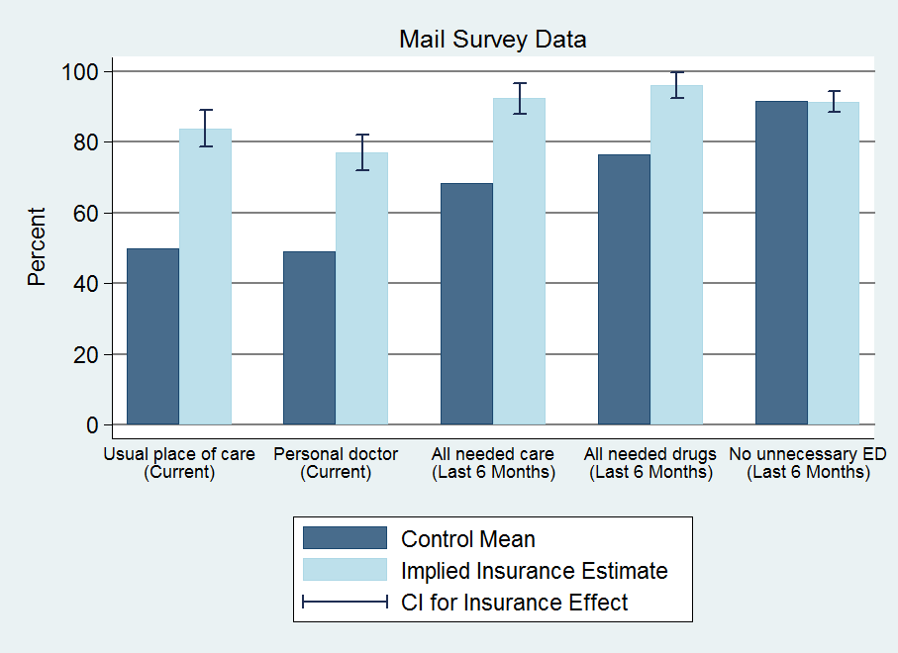
Medicaid Increases Access to Health Care
Source: Quarterly journal of economics 2012
Medicaid: What Does It Do and What Does That Mean?

Slide 34
Health Care Utilization (summary)
Increased utilization
30% ↑ probability of hospital admission
35% ↑ probability of outpatient visit
15% ↑ probability of taking prescription drugs
40% ↑ in number of ER visits
↑ in compliance with recommended preventive care
Increased total health care spending
25% ↑ total, annual spending (hospital, outpatient, ER, drugs)
Medicaid: What Does It Do and What Does That Mean?

Slide 35
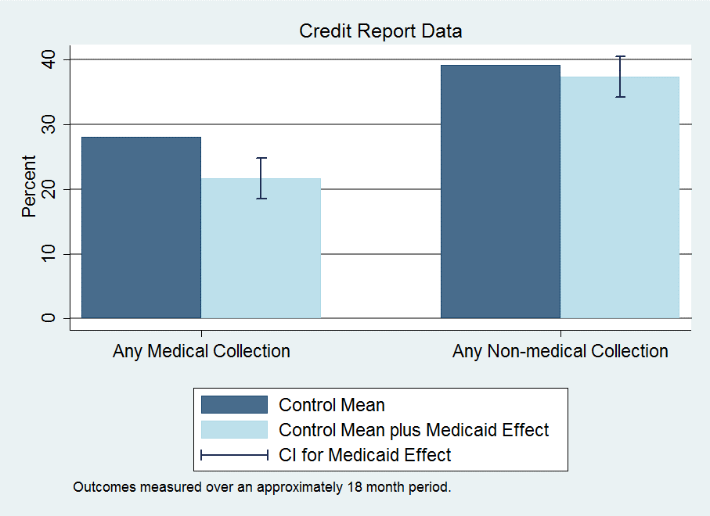
Medicaid Increases Economic Security
Medicaid Increases Economic Security
Source: Quarterly journal of economics 2012
Medicaid: What Does It Do and What Does That Mean?

Slide 36
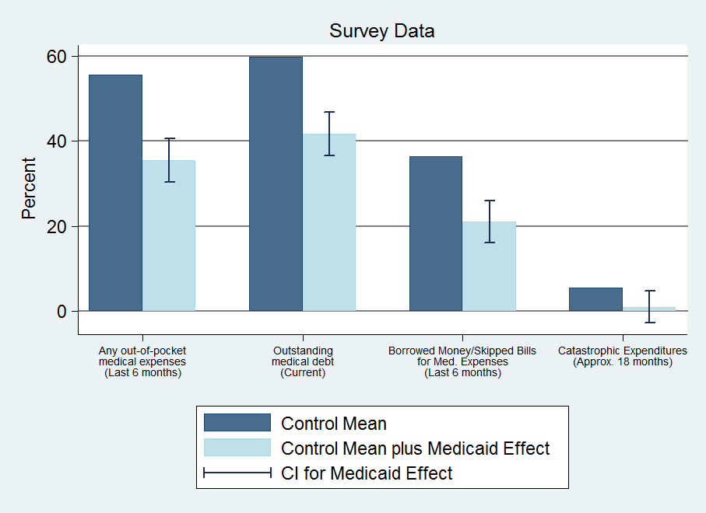
Medicaid Increases Economic Security
Source: Quarterly journal of economics 2012; New England Journal of Medicine 2013
Medicaid: What Does It Do and What Does That Mean?

Slide 37
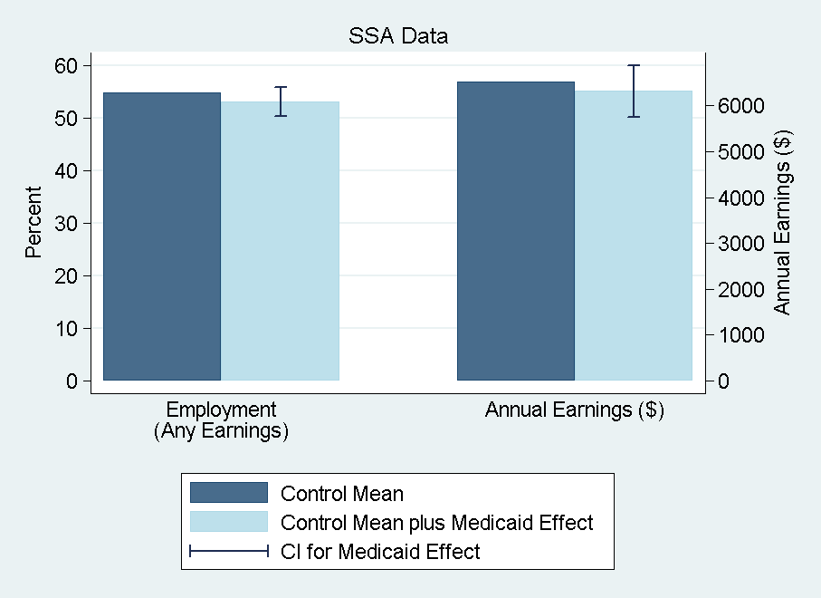
No Detectable Impact on Earnings and Employment
Source: AER P&P 2014
Medicaid: What Does It Do and What Does That Mean?

Slide 38
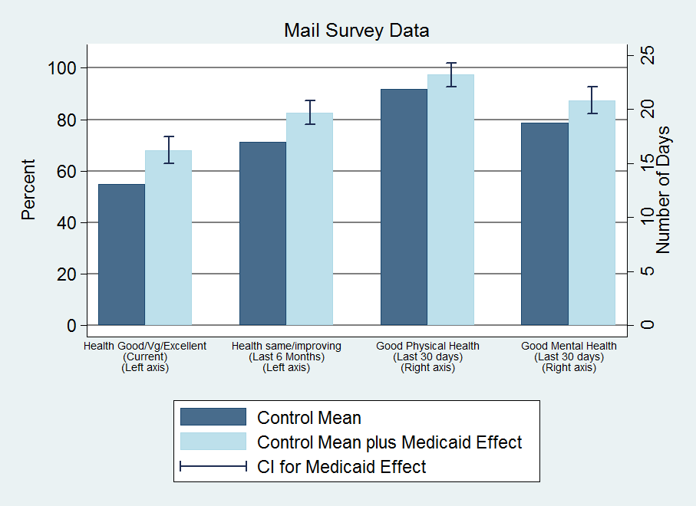
Medicaid Improves Self-Reported Health
Source: Quarterly journal of economics 2012
Medicaid: What Does It Do and What Does That Mean?

Slide 39
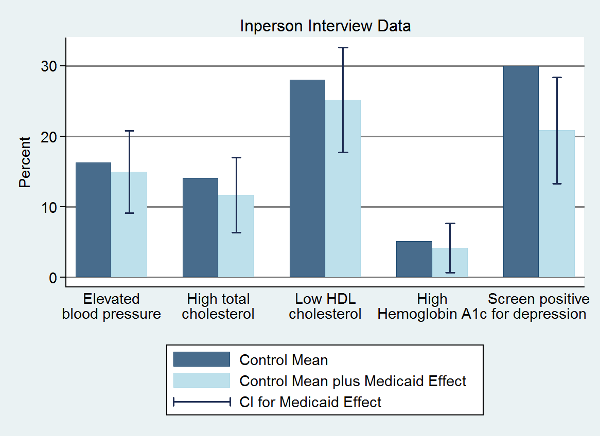
No Detectable Effect On Physical Health
No Detectable Impact on Physical Health
Source: New England Journal of Medicine, 2013
Medicaid: What Does It Do and What Does That Mean?

Slide 40
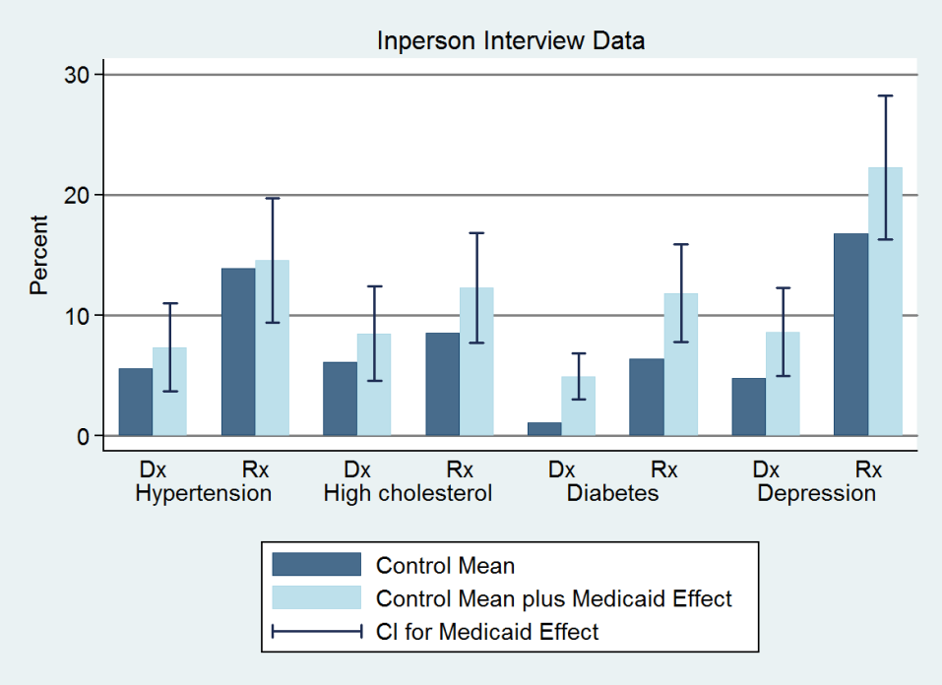
Medicaid Increases Diagnosis and Medication
Source: New England Journal of Medicine 2013
Medicaid: What Does It Do and What Does That Mean?

Slide 41
Health Results: Discussion
Health benefits from Medicaid
Improves self-reported health
Reduces depression (by ~9 pctg pts or 30%)
No detectable impact on blood pressure, cholesterol, or blood sugar
Chosen because they are important, measurable health problems in this population and have been shown in clinical trials to be modifiable with effective treatment within our time frame
Cannot reject decline in blood sugar predicted by the effect we see on diabetes medication + clinical trials of effects of such medication
Can reject declines in blood pressure found in quasi-experimental Medicaid studies
Medicaid: What Does It Do and What Does That Mean?

Slide 42
Health Insurance and Mortality
Subsequent, important work rejecting the null hypothesis that health insurance (or Medicaid) has no impact on adult (50-64 year old) mortality
Goldin et al. (QJE 2021) IRS experiment (sample size: 4 million!)
Miller et al. (QJE 2021) and Wyse and Meyer (2024): Medicaid expansions
But magnitudes are modest
E.g. Meyer and Wyse estimate that enrolling all uninsured in Medicaid would reduce (substantial) mortality gap between high and low income by ~10 percent
Consistent with substantial income-mortality gradients in countries with universal coverage (Norway, Sweden…)
Why?
Stay tuned…
Medicaid: What Does It Do and What Does That Mean?

Slide 43
Summary: Medicaid Effects After 1-2 years
Increased health care use across the board
Hosp, ER, primary care, drugs, preventive care
~25% ↑ total, annual spending (hospital, outpatient, drugs)
Improved some measures of financial well-being
Reduced out-of-pocket costs and medical debt
Virtually eliminated “catastrophic” out-of-pocket spending
No detectable effect on earnings and employment
Improved some measures of health
Improved self-reported health
Reduced depression
No statistically significant effects on measured physical health
Medicaid: What Does It Do and What Does That Mean?

Slide 44
{Interlude: Key Open Empirical Questions}
Large literature on empirical impact of formal health insurance coverage
Some open questions include:
Impact of health insurance on consumption (level and variance)
Consequences to individuals of medical debt (but see Kluender et al. NBER WP 32315)
Impact on health
Stock, not flow
Paucity of non-mortality measures
For more discussion see Finkelstein, Notowidigdo and Mahoney (2018): “What Does (Formal) Health Insurance Do, and For Whom?”

Slide 45
{Interlude: Beyond Mortality}
Health economists needs to find (representative) data to study physical and mental health
Key challenge: usually only well-measured at scale if use health care (selection problems)
Recent advances:
Minimum data set – rich, detailed physical and health measures on all nursing home residents (Einav et al 2022; NBER WP 30228)
Measuring chronic diseases in countries with no access gradient (Danesh et al. 2024; NBER WP 32577)
… more needed!
Two projects in progress / pursuit…
Medicaid: What Does It Do and What Does That Mean?

Slide 46
Effects of Medicaid on Non-Recipients
Low-income uninsured pay only ~20 cents on the dollar for their medical spending
National estimates: uninsured pay 20 – 35 cents on the dollar for their medical care
Remainder is charity care (i.e. by non-profit hospitals and public clinics) and bad debt
Implications:
Low income “uninsured” have substantial implicit insurance (may explain modest health impacts)
Medicaid recipients not the only Medicaid beneficiaries
In Oregon, we estimate that for every dollar of Medicaid spending, about $0.60 represents a transfer to the providers of implicit insurance for the low-income uninsured
Notes:
Explain why less than 80 cents!

Slide 47
Extrapolating Beyond the Experiment
Context quite relevant for health care reform
Population covered by Medicaid in our study basically the same as those covered by 2014 ACA expansion of Medicaid or uncovered by potential repeal
But important caveats to bear in mind:
Time pattern of effects (1-2 years vs. longer run)
Partial vs. general equilibrium effects (Finkelstein QJE 2007)
Heterogeneity in treatment effects
Representativeness of Oregon (population; health care system)
Selection on gains?
Voluntary vs. mandatory enrollment (“selection on moral hazard” (Einav et al AER 2013))
Medicaid: What Does It Do and What Does That Mean?

Slide 48
Updating Based on Our Findings
“No insurance is horrible, insurance is good. Like they needed a study to figure this one out.”
- Oregon lottery participant
Medicaid: What Does It Do and What Does That Mean?

Slide 49
Updating Based on Our Findings
“Medicaid is worthless”
Not true: Increases in utilization, perceived access and quality, reductions in financial strain, and improvement in self-reported health
“Covering the uninsured will get them out of the Emergency Room”
Not true: Medicaid increases use of ER (overall and for a broad range of visit types)
“Health insurance expansion saves money”
Not true in short run: increases in health care use
In long run, remains to be seen: increases in preventive care and improvements in self-reported health
Medicaid: What Does It Do and What Does That Mean?

Slide 50
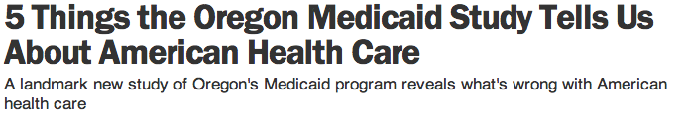
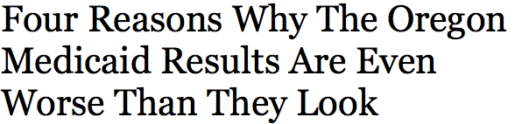
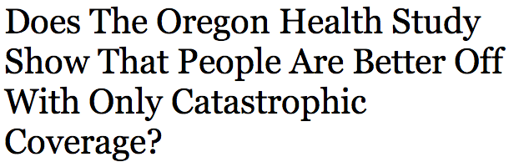

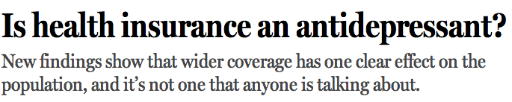

Tremendous Media Response
Medicaid: What Does It Do and What Does That Mean?

Slide 51
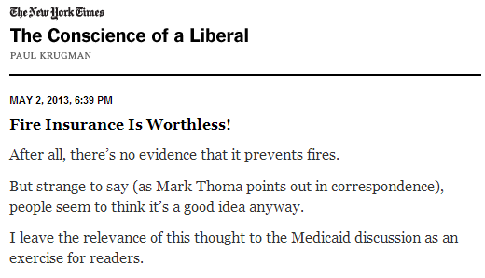
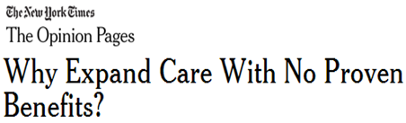
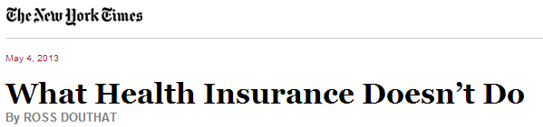

Reframing the Debate
Medicaid: What Does It Do and What Does That Mean?

Slide 52
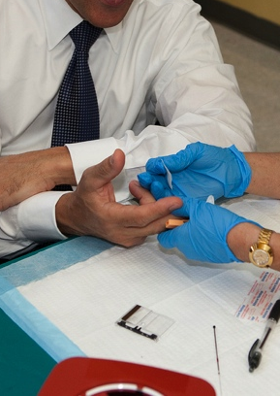
Beyond Oregon: Where Do We Go from Here?
Critical need for more randomized evaluations in domestic policy
Oregon shouldn’t get so much media attention
Randomized evaluations on health care policy ideally closer to norm than exception
i.e. RCTs on how health care is delivered: health insurance, increase use of “appropriate” care, care coordination…
Medicaid: What Does It Do and What Does That Mean?

Slide 53
Use of RCTs in U.S. Health Care Delivery (Finkelstein and Taubman, Science 2015)
Limited use to date
Search of top medical, economics, and health services journals
18 percent of U.S. health care delivery interventions randomized
Greater use of RCTs for U.S. medical interventions
80 percent of U.S.-based medical treatment studies randomized
True of both drug (86 percent) and non-drug (66 percent) interventions
Greater use of RCTs for other social policy
36 percent of U.S. education studies
46 percent of international development studies
Medicaid: What Does It Do and What Does That Mean?

Slide 54
Possibility of a New Era
Increasing demand for credible evidence
Increasing public sector budgets (e.g. Medicaid expansion under ACA)
Increasing “skin in the game” for private sector (in part due to ACA)
Reductions in Medicare payments to hospitals for excess readmission rates
Accountable Care Organizations (ACOs) with shared savings if meet quality targets for Medicare patients but reduce costs
Private sector analogs (e.g. Alternative Quality Contract in MA BCBS)
Medicaid: What Does It Do and What Does That Mean?

Slide 55
Potential Challenges to Health Care RCTs
Ethics of rationing
Programs often oversubscribed, rolled out gradually, or initially tested with a pilot program
Time and cost considerations
RCTs need not, and often do not, add to costs of prospective research
Randomizing who is offered program and following study population in administrative data can reduce recruitment and follow-up costs
Yields causal estimates even without full take-up (adherence)
Can deliver both “real-time” results for practitioners and long-term impacts
Medicaid: What Does It Do and What Does That Mean?

Slide 56
Potential Challenges to Health Care RCTs
Ability to study reforms to entire system or area of care
Randomize across providers, care-setting, etc. (about one-fifth of existing RCTs)
Some system-wide interventions can be studied via patient-level randomization (e.g. shared savings contracts)
Possibility for system-wide RCTs
But see CMMI market-wide payment reform RCTs!!
bundled payment for joint replacement
incentives for home dialysis
site neutral radiation oncology…
Medicaid: What Does It Do and What Does That Mean?

Slide 57
Reducing Barriers to RCTs in Health Policy
Typically conducted like medical trials:
Recruit and consent patients
Follow up with primary data collection
Alternative approach can be substantially lower cost
Randomize, with waiver of informed consent, an offer of intervention
All those in study (including those who do not accept) followed passively in administrative data
E.g. EMRs, insurance claims data, state discharge data sets, etc.
Low take-up (adherence to assigned protocol) reduces statistical power but does not interfere with obtaining consistent estimates of program’s causal effects
Can run much larger trials with more representative samples at substantially lower cost
Medicaid: What Does It Do and What Does That Mean?

Slide 58
J-PAL NA US Health Care Delivery Initiative
Goal: Encourage and support RCTs aimed at improving efficiency of US health care delivery
Identify implementing partners who have innovative ideas and are committed to rigorous evaluation and match with researchers
Support randomized evaluations (financially and technically) and help translate findings into action
Medicaid: What Does It Do and What Does That Mean?

Slide 59
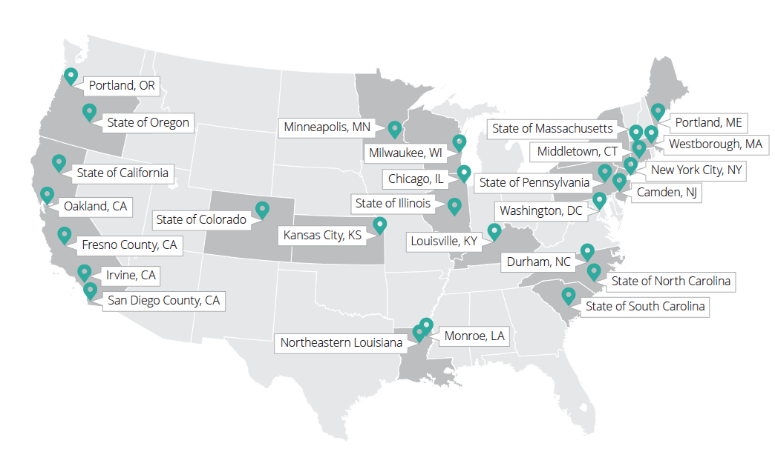
J-PAL’s U.S. Health Care Delivery Initiative (HCDI)
See J-PAL North America’s website for more information on HCDI’s projects.

Slide 60
Examples of recent healthcare RCTs
Health care Hot Spotting (Finkelstein et al. NEJM 2020)
Patient-level randomization of a high-profile hospital discharge program
Designed to connect complex, high-need patients with available services
No impact on hospital readmissions (Why? In progress…)
Impact of provider race on health behaviors of black men (Alsan et al. AER 2019)
Randomized black men to black vs white MD
ex ante demand for preventive services unchanged, but ex-post increased, especially for invasive services (e.g. cholesterol screening)
Peer comparison letters for high-volume primary care prescribers (Sacarny et al. JAMA Psychiatry 2018)
Worked with White House SBST and CMS’s Center for Policy Integrity
Physician-level randomization of warning letters to “outlier prescribers”
Letters reduced prescribing for at least two years; no evidence of negative patient effects
Workplace wellness programs (Jones et al. QJE 2019; Baicker and Song. JAMA 2019)
One randomized at employee level within workplace, one at site level
No impact on most measured health outcomes or employee behavior
Healthy select into workplace wellness suggesting may be attractive for employers anyway
Medicaid: What Does It Do and What Does That Mean?
Notes:
Additional Notes:

Slide 61

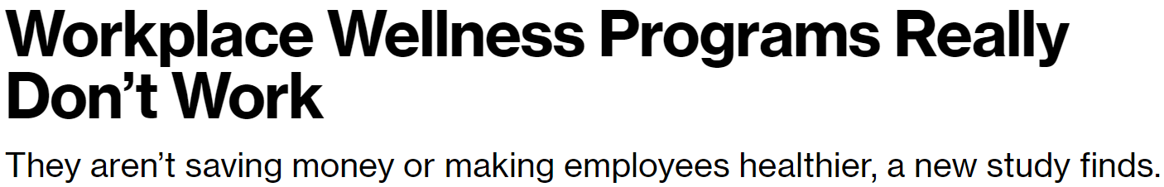
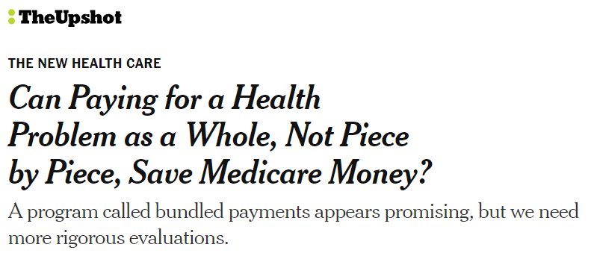

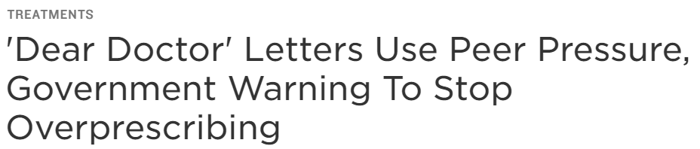

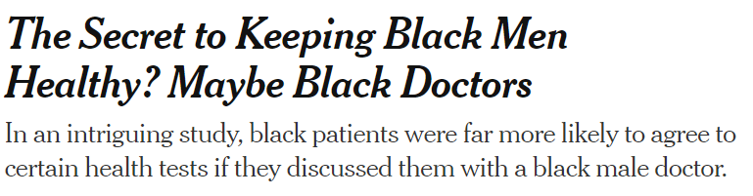

RCT evidence gets attention
Notes:
These studies received major media coverage → Why? Policy-relevant and understudied topics, rigorous and relatively easy to understand methodology

Slide 62
Recap and Next Steps
Medicaid: What Does It Do?
Results from Randomized Evaluation
Medicaid increases health care use, improves economic security, and improves some health measures
NB: Medicaid recipients not the only beneficiaries
Up Next: What Do The Results Mean?
From descriptive to normative
Value of Medicaid?
Welfare analysis of impact of Medicaid
Medicaid: What Does It Do and What Does That Mean?

Slide 63
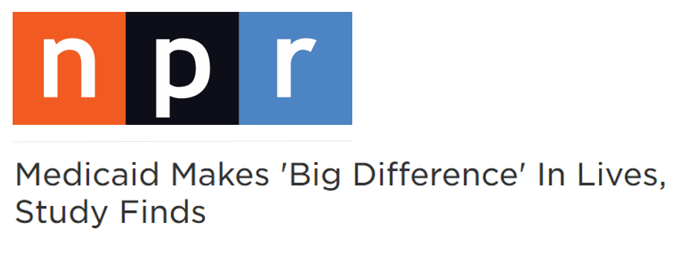

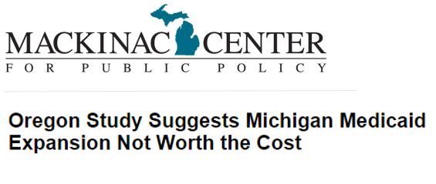
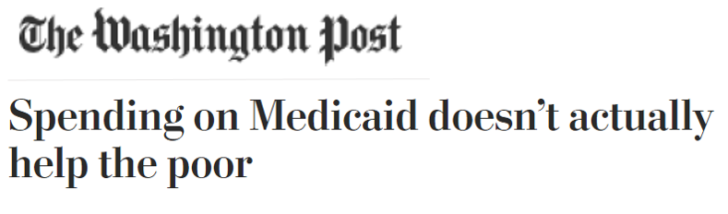
Informal Welfare Analysis Inconclusive
According to the media:
According to think tanks:
Medicaid: What Does It Do and What Does That Mean?

Slide 64
Part II: What Can We Learn from Formal Welfare Analysis?
Goal: Estimate the (monetary) value of Medicaid to recipients
Will require more assumptions (and therefore caveats) than direct experimental estimates of impacts
Undertook two very different approaches
Robust result: Medicaid’s value to recipients is substantially below Medicaid spending (20-50 cents on the dollar)
Important driver: low-income “uninsured” pay a small share of their medical costs
The implicit insurers of the uninsured (e.g. hospitals) are an important beneficiary of Medicaid coverage
Medicaid: What Does It Do and What Does That Mean?

Slide 65
Welfare Analysis: Framework
Individuals derive utility (well-being) from health h and (non-medical) consumption c, and potentially other things.
u=u(c,h,…)
Health h is produced according to h = H(m;θ) where
m denotes medical spending
θ denotes distribution of potential health shocks.
Goal: estimate recipient’s value of Medicaid (V)
Definition: V is the amount of money we could take away from Medicaid recipient that would leave him indifferent between having Medicaid (without V) and being uninsured
Recipient’s value may differ from society’s value

Slide 66
Road map
Estimating value of in-kind subsidies is hard!
Especially if they are not traded in a well functioning market
Will spend some time describing and discussing some potential empirical approaches
But first let’s fast-forward and assume we have a credible estimate of V
What will we do with it?
NB: Always useful exercise to do at start of an empirical research project!

Slide 67
Benchmark: MVPF
Estimate V using both ex-post approaches and get similar results. Now what do we do with it?
One natural approach: compare value of Medicaid to its cost
i.e. calculate MVPF:
Recipient value (WTP) relative to cost
Note: MVPF above vs below 1 answers question: if Medicaid recipients had to pay actuarial cost of Medicaid, would they prefer to remain uninsured?
What is cost of Medicaid in MVPF formula?
Recall: Cost = mechanical cost + fiscal externality
Medicaid: What Does It Do and What Does That Mean?

Slide 68
Medicaid Cost
Cost = Mechanical Cost + Fiscal Externality
Mechanical cost: cost holding behavior fixed
healthcare spending on uninsured
{ignoring administrative costs}
Fiscal externality: impact of behavioral response to policy on government budget
Increase in healthcare sending due to insurance (moral hazard)
{Ignoring other potential fiscal externalities – e.g. labor supply effects of Medicaid that affect government tax revenue}
Medicaid: What Does It Do and What Does That Mean?

Slide 69
Other possible benchmarks
Gross cost of Medicaid is substantially above net (i.e. real resource cost) of Medicaid
The low-income "uninsured" in fact receive substantial uncompensated care (ex-ante charity care by non profit and public providers; ex-post charity care through unpaid debt and bankruptcy)
On average pay about 20 cents on the dollar for their medical care
Net cost of Medicaid is only 40 percent of gross cost
Value of Medicaid above / below net cost answers question: is it efficient to provide Medicaid?
i.e. is WTP above social cost?
Medicaid: What Does It Do and What Does That Mean?

Slide 70
WTP relative to net cost
Referee comment: clearly WTP must be below net cost.
If willingness to pay were above net cost, private market would come in and provide it and undercut government (unless we think government is more efficient at offering health insurance)
Please respond to referee!
Why might WTP be above net cost?
Why might WTP be below net cost?
Medicaid: What Does It Do and What Does That Mean?

Slide 71
Thus far: two benchmarks
(V / Gross Costs) vs 1: If recipients had to pay the actuarial cost of Medicaid would they prefer being uninsured
(V/Net Costs) vs 1: Is allocation efficient? i.e. is recipient willingness to pay above social cost
So are we done?
Medicaid: What Does It Do and What Does That Mean?

Slide 72
Other Benchmarks
Response at Chicago to an initial presentation:
“Well of course their willingness to pay is lower than costs, Amy… they’re poor after all!”
Let’s not forget distributional analysis!
Medicaid: What Does It Do and What Does That Mean?

Slide 73
Distributional analysis
V represents recipient value of Medicaid
Society’s value of Medicaid may exceed low-income recipient’s value
e.g. utilitarian SWF - marginal utility of consumption higher for poor
SWF may be more concave, so that social marginal utility of consumption for poor is even higher
Redistribution is not costless - Okun's (1975) "leaky bucket”
Society may be willing to spend more than a dollar to transfer a dollar to the poor
Why? Because social marginal of consumption for low income above own private marginal utility of consumption
Medicaid: What Does It Do and What Does That Mean?

Slide 74
Distributional analysis (con’t)
Two approaches to distributional analysis
Social cost benefit test
MVPF compared to other programs
Can we transfer to the low income more efficiently through Medicaid or through other programs (e.g. cash transfer through EITC)?
See earlier lecture on MVPF
Social cost benefit test
Use a social welfare function to translate individual WTP (V) into a social willingness to pay (SV) – Saez and Stantcheva 2016
Then compare SV to gross or net costs
Medicaid: What Does It Do and What Does That Mean?

Slide 75
Social Cost Benefit Test
Requires specifying a SWF
Consider for example a utilitarian SWF
SV of Medicaid is recipient value time the ratio of marginal utility of consumption for the recipient to the marginal utility of consumption of the average person in the population
E.g. in Oregon recipient consumption is about 2/5 of average in population
If we assume CRRA utility with coefficient of relative risk aversion of 3 this implies mu of consumption is 1/c^3
So SV is 15 times recipient value! = (1/0.4) ^3
Even with log utility SV is 2.5 times recipient value
Medicaid: What Does It Do and What Does That Mean?

Slide 76
Road map
Now have some idea of what we might do with V once we estimate it
i.e. have discussed various benchmarks
And will return to them once we estimate V
Now let’s return to the empirical challenge of estimating V!
Medicaid: What Does It Do and What Does That Mean?

Slide 77
Two Approaches to Estimating V
Ex-post approach: Use estimated outcomes for individuals with Medicaid and without Medicaid to infer and compare utility with and without Medicaid
Based on: Finkelstein, Hendren, Luttmer (2019) “The Value of Medicaid: Interpreting the Results from the Oregon Health Insurance Experiment”
Ex-ante approach: Estimate demand curve for Medicaid
Demand curve reveals willingness to pay (value)
Based on: Finkelstein, Hendren, Shepard (2019) “The Value of Health Insurance for Low Income Adults: Evidence from Massachusetts”
Medicaid: What Does It Do and What Does That Mean?

Slide 78
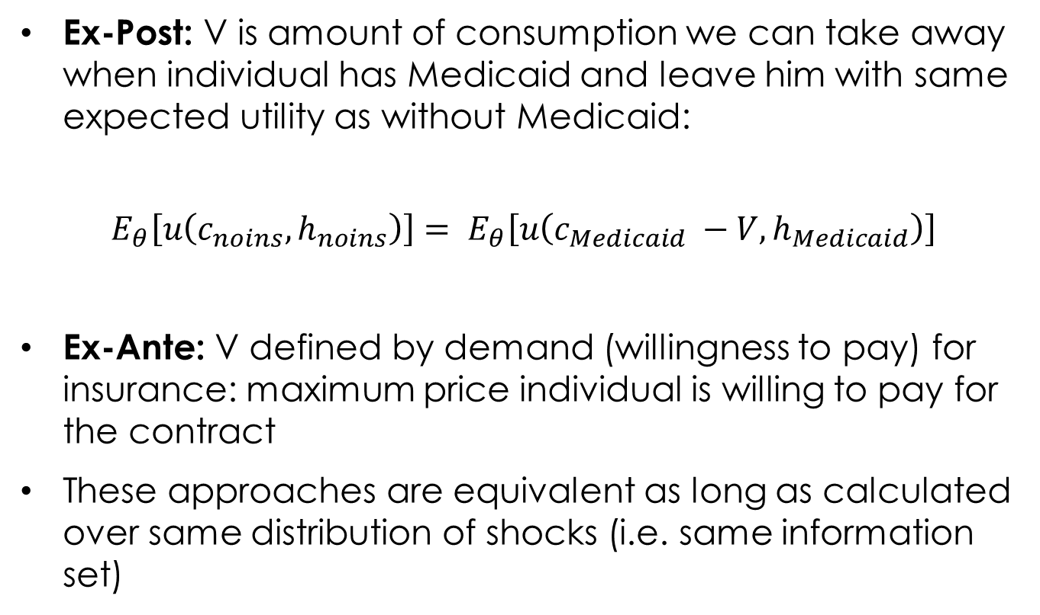
Ex-post and Ex-ante Approaches: Overview
Ex-Post: V is amount of consumption we can take away when individual has Medicaid and leave him with same expected utility as without Medicaid:
$$E_{θ}\left[u\left(c_{noins},h_{noins}\right)\right]= E_{θ}\left[u\left(c_{Medicaid} −V,h_{Medicaid}\right)\right]$$
Ex-Ante: V defined by demand (willingness to pay) for insurance: maximum price individual is willing to pay for the contract
These approaches are equivalent as long as calculated over same distribution of shocks (i.e. same information set)
Medicaid: What Does It Do and What Does That Mean?

Slide 79
Links across other lectures
Einav-Finkelstein-Cullen: used ex-ante WTP estimates to evaluate welfare effects of adverse selection
Baily-Chetty: used ex-post estimates of program effects to evaluate welfare effects of changes in social insurance benefit levels.
- We will describe two ex-post approaches, one of which is similar in spirit to Baily-Chetty and one is not.
Medicaid: What Does It Do and What Does That Mean?

Slide 80
Two ex-post approaches
Complete information approach
Completely specify normative utility function and estimate causal effect of Medicaid on distribution of all utility-relevant arguments
Here: Consumption and Health
Don't assume consumer optimization or how Medicaid affects budget set
Optimization approach
Assume consumer optimization and model the budget set
Only specify marginal utility function over one argument * Estimate causal effect of Medicaid on only that marginal utility function
Applications: Consumption- and Health-Based Optimization Approach (over-identification)
Medicaid: What Does It Do and What Does That Mean?

Slide 81
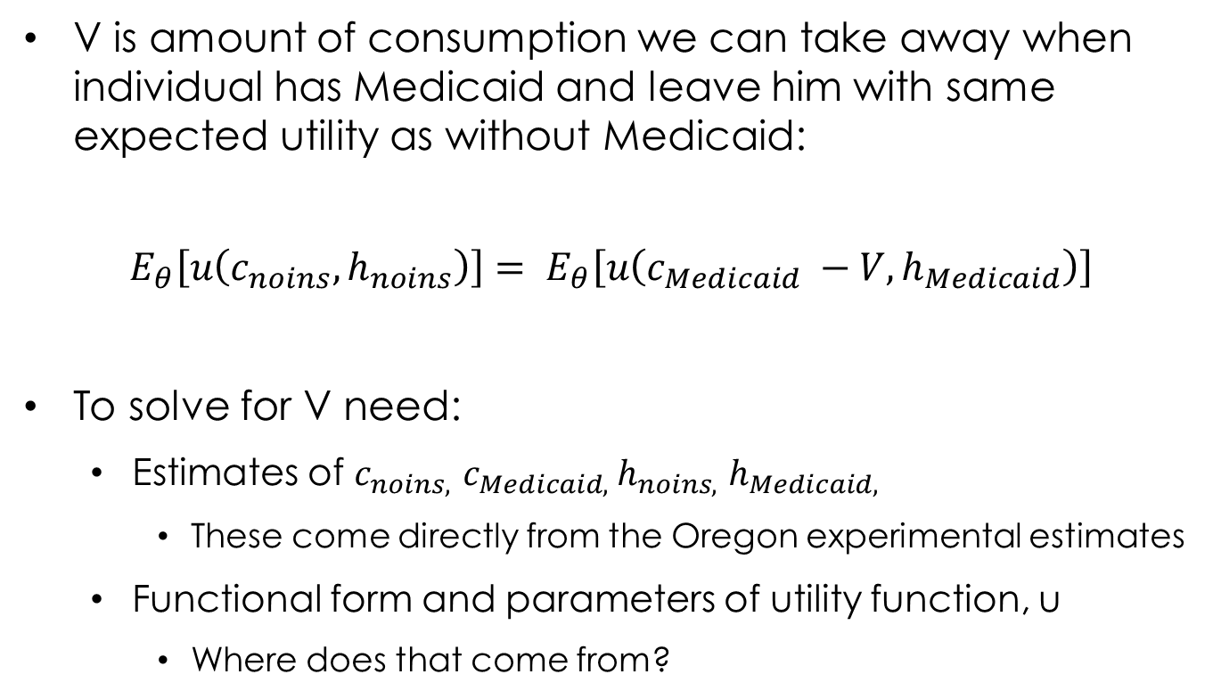
Complete Information Ex-Post Approach
V is amount of consumption we can take away when individual has Medicaid and leave him with same expected utility as without Medicaid:
$$E_{θ}\left[u\left(c_{noins},h_{noins}\right)\right]= E_{θ}\left[u\left(c_{Medicaid} −V,h_{Medicaid}\right)\right]$$
To solve for V need:
Estimates of $c_{noins, }$ $c_{Medicaid, }h_{noins, }$ $h_{Medicaid, }$
These come directly from the Oregon experimental estimates
Functional form and parameters of utility function, u
Where does that come from?

Slide 82
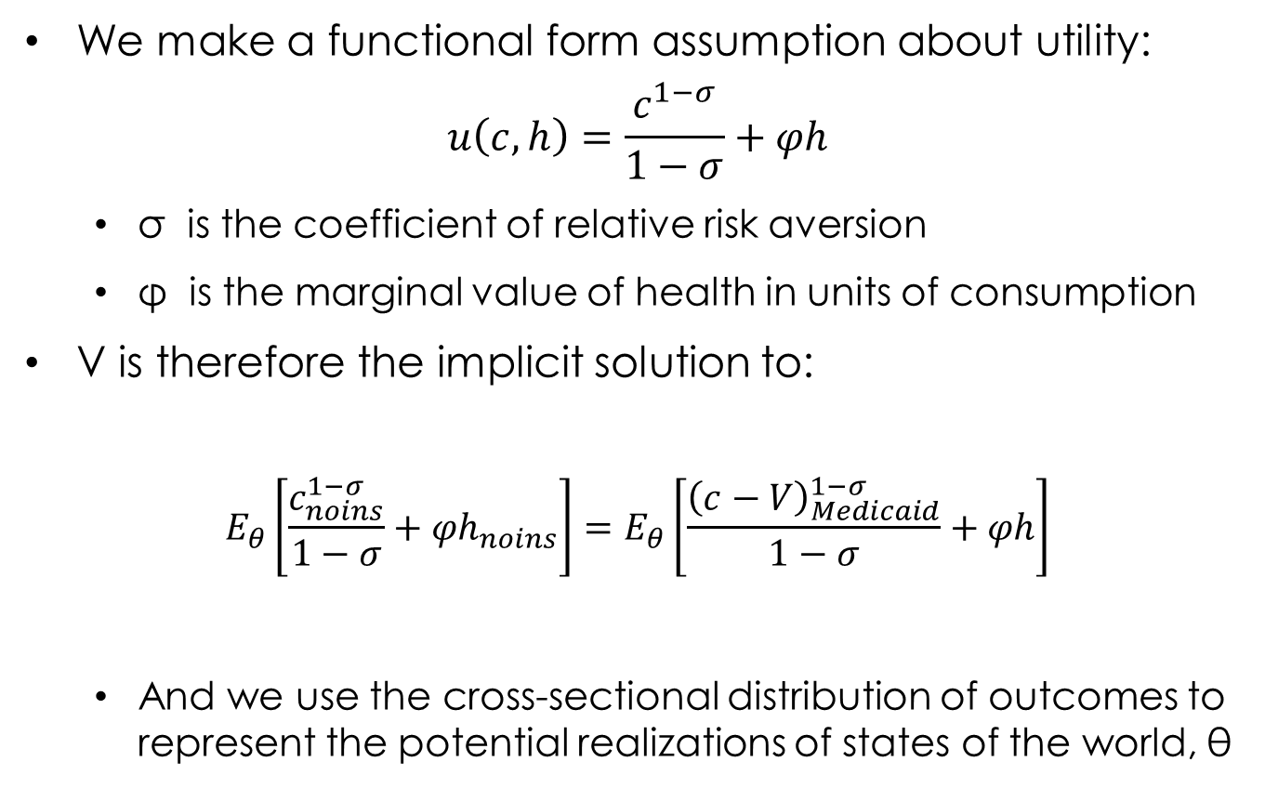
Complete Information Ex-post Approach
We make a functional form assumption about utility:
$$u\left(c,h\right)=\frac{c^{1−σ}}{1−σ}+φh$$
σ is the coefficient of relative risk aversion
φ is the marginal value of health in units of consumption
V is therefore the implicit solution to:
$$E_{θ}\left[\frac{c_{noins}^{1−σ}}{1−σ}+{φh}_{noins}\right]=E_{θ}\left[\frac{{\left(c−V\right)}_{Medicaid}^{1−σ}}{1−σ}+φh\right]$$
And we use the cross-sectional distribution of outcomes to represent the potential realizations of states of the world, θ
Medicaid: What Does It Do and What Does That Mean?

Slide 83


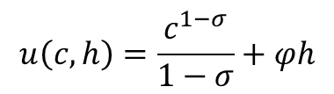
What Do We Think of this Approach?
Attractions:
Provides mapping from experimental estimates of impact of Medicaid on health and consumption to V
Don’t have to take a stand on whether the individual is behaving “optimally”
Concern: Where did that utility function come from?
Need to assume a particular form for utility over c and h
Need to calibrate and
What about other arguments of the utility function that could be affected?
Debt, family structure, marital stability, children’s outcomes etc…
$$u\left(c,h\right)=\frac{c^{1−σ}}{1−σ}+φh$$
Medicaid: What Does It Do and What Does That Mean?

Slide 84
Variant: Optimization Approach
Ex-post approach that reduces information requirements through two additional assumptions
Two key economic assumptions:
Program structure: Model Medicaid as affecting the individual solely through its impact on out of pocket expenses
Allows us to model Medicaid through its impact on budget constraint
Allows us to engage in the thought experiment of a marginal increase in Medicaid (conceptually: a marginal change in cost-sharing – i.e. mapping out m to out of pocket costs)
Individuals choose medical care m and non-medical consumptions c optimally, given their budget constraint
Why is neither assumption innocuous?
Medicaid: What Does It Do and What Does That Mean?

Slide 85
What Do These Assumptions Buy Us?
The power of the envelope theorem
Can value Medicaid solely through one argument of utility (e.g., c or h)
Intuition: because the recipient chooses c and h optimally, a marginal reallocation between c and h has no first order effect on welfare
Why is this exciting? Avoids the “endless arguments” issue.
Medicaid: What Does It Do and What Does That Mean?

Slide 86
From Marginal to Total Value
To make inferences about non-marginal changes in the individual’s budget set (e.g. covering an uninsured individual with Medicaid), require an additional statistical assumption to interpolate between local estimates
Can estimate marginal value of first unit of Medicaid (100% coinsurance) and last unit of insurance (0% coinsurance)
Statistical assumption substitutes for the economic assumptions about utility function in complete information approach
E.g. linear interpolation between first and last value
Medicaid: What Does It Do and What Does That Mean?

Slide 87
Findings from ex-post approach
Value of formal insurance to recipients is substantially below insurance costs (i.e. medical claims payments)
Value is about one-fifth to one-half of Medicaid costs
Medicaid recipients value each dollar of Medicaid spending at 20 to 50 cents on the dollar
Consistent with low take-up of subsidized insurance
Implication: low-income uninsured would prefer to be uninsured than have Medicaid and have to pay its cost
Key driver: low-income “uninsured” have implicit insurance
$0.60 of every $ of Medicaid spending is a transfer to the providers of this implicit insurance
Lowers value of Medicaid to recipients for two reasons:
Accounting: 60 cents / dollar of Medicaid spending does not go directly to recipient
Concavity of utility: First unit of insurance most valuable

Slide 88
Pros and Cons of Ex-post Approach
Attraction: Provides a mapping from experimental estimates of impact of Medicaid on health and consumption to V
Limitations
Have to assume a utility function
Measurement challenges
Consumption
Heath Measures
Calibration choices for risk aversion and monetary values of health

Slide 89
Ex-ante Approach
Demand curve shows willingness to pay for insurance
V is the maximum price at which indifferent to buying insurance or not
Implementation: To estimate demand curve, randomly vary price and see how many buy at different price levels
Normative interpretation of V requires that revealed preference (“demand reveals value”).
May be violated if individuals are inattentive, mis-informed etc.,
But unlike ex-post approach do not have to specify a utility function

Slide 90
Key Assumption: Demand Curve Reveals Value
Standard assumption / bread and butter of economic analyses of all kinds
Why might demand not reveal value?
Behavioral frictions (inattention, mis-information etc – Spinnewijn, 2017)
Information has already been revealed, thus destroying insurance value (Hendren 2017 “Measuring ex-ante welfare in insurance markets”))
Observed demand (estimated once some information has been revealed) vs ex-ante demand
What about low demand due to liquidity constraints?
Medicaid: What Does It Do and What Does That Mean?

Slide 91
Application: Massachusetts
Subsidized health insurance exchange in MA introduced in 2006 “Romneycare” reform
Precursor to ACA exchanges
Subsidies for low-income, non-elderly uninsured adults between 133-300% of federal poverty line
Use quasi-random price across individuals to estimate demand
Public subsidies – designed to make insurance “affordable”
increase at discrete income bins
Regression discontinuity design
Medicaid: What Does It Do and What Does That Mean?

Slide 92
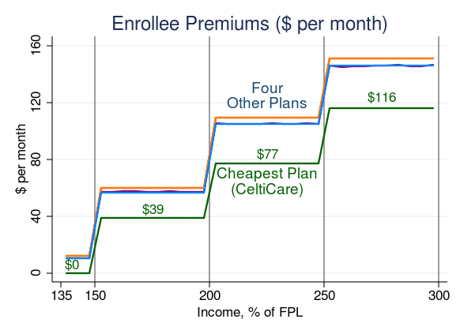
Quasi-Random Variation in Price
Medicaid: What Does It Do and What Does That Mean?

Slide 93
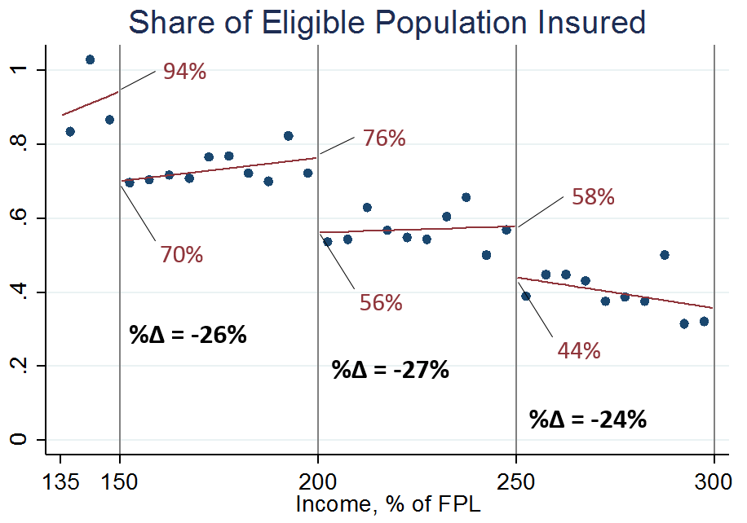
Price Changes Prompt Coverage Changes
Medicaid: What Does It Do and What Does That Mean?

Slide 94
Observed Demand Points
125
(0.44, $116)
100
250% FPL
75
(0.58, $77)
(0.56, $77)
$/month
200% FPL
50
(0.76, $39)
(0.70, $39)
25
150% FPL
0
(0.94, $0)
.2
.4
.6
.8
1
Share with Formal Insurance
Notes:
Example: at 149% of poverty p_L =0 and 94% buy; at 151% of poverty p_L is $39 and 70% buy..
Run through the next 7 slides pretty quickly but just here to show how can construct WTP curves from the data…

Slide 95
WTP (Adjusted to 150% FPL)
125
(0.36, $116)
Assumption
WTP(s,y) = WTP(s + λ_{y}, 150%)
WTP^{250% FPL}
100
75
(0.50, $77)
$/month
WTP^{200% FPL}
50
Adjusted WTP
(150% FPL)
(0.70, $39)
25
WTP^{150% FPL}
0
(0.94, $0)
.2
.4
.6
.8
1
Share with Formal Insurance
Notes:
In principle could identify W_L using only one premium disconintuity. But we want to combine data from all three to observe demand over a wider range of premiums.
Note that therefore at two enrollee premiums we observe (and plot) two different market shares: this is because each pricing discontinuity identifies a demand curve for indivdiuals at a given income level and these demand curves need not be the same. E.g. premiums that apply between 150-200% FPL identify one point on the demand curve for 150% FPL (right of that discontinuity) and one point on the demand curve for 200% FPL (left of that discontinuity).
In practice demand varies little with income (market shares relatively flat in constant premium range) so demand line segments for three income groups nearly interest.
To adjust: allow willingness to pay to vary with income; assume income functions as a horizontal shifter of the WTP curves.

Slide 96
Demand Curve
125
(0.36, $116)
100
Half of eligible sample values insurance at less than $77 per month
75
(0.50, $77)
$/month
50
(0.70, $39)
25
0
(0.94, $0)
.2
.4
.6
.8
1
Share with Formal Insurance

Slide 97
Average Insurer Costs
420
RD = 47.3
RD = 32.4
RD = 6.2
(7.7)
(8.7)
(11.9)
%Δ = +15%
%Δ = +9%
%Δ = +2%
380
$ / month
340
300
133
150
200
250
300
Income, % of Poverty

Slide 98
Observed Average Costs
150% FPL
400
Average
200% FPL
Cost
300
250% FPL
$ per month
200
100
0
.2
.3
.4
.5
.6
.7
.8
.9
1
Share with Formal Insurance
Notes:
AC with MC points

Slide 99
Average Cost (Adjusted to 150% FPL)
150% FPL Adjustment
400
Average
200% FPL
Cost
300
250% FPL
$ per month
200
100
0
.2
.3
.4
.5
.6
.7
.8
.9
1
Share with Formal Insurance
Notes:
Adjust average cost curves to obtain a single curve applicable to individuals at 150% of FPL – we assume slopes ofaverage cost curves are stable with income so we can vertically shift the average cost curves for 200 and 250% FPL thresholds to align w the 150% FPL threshold. (this assumes slopes of ac curves wrt s are staple with income even though thelevels of costs are decliningin income)

Slide 100
Final WTP and Cost Curves
400
Average Cost
300
$ per month
200
Cost of Marginal Enrollee
WTP
100
0
.2
.3
.4
.5
.6
.7
.8
.9
1
Share with Formal Insurance
Notes:
Adjusted MC and AC with WTP_H

Slide 101
Little Take-up w/out Large Subsidies
400
Average Cost
300
$ per month
Cost of Marginal Enrollee
200
WTP
Demand well below average cost
Premium of 25% of AC → 49% take-up
Premium of 10% of AC → 79% take-up
100
0
.2
.3
.4
.5
.6
.7
.8
.9
1
Share with Formal Insurance

Slide 102
Adverse selection alone cannot explain low coverage
400
Average Cost
300
$ per month
Cost of Marginal Enrollee
200
WTP
Demand also well below enrollees’ own expected costs
100
0
.2
.3
.4
.5
.6
.7
.8
.9
1
Share with Formal Insurance

Slide 103
Why is WTP Below Own Costs?
Moral hazard – textbook reason for WTP < Cost
But required magnitude not plausible
Moral hazard would have to increase costs by a factor of 200% to explain gap between WTP and Costs
Oregon experiment: Moral hazard increases healthcare costs by 25%
Uncompensated care (charity care, unpaid bills)
Low-income individuals pay ~20% of their medical expenditures out of pocket
Use this + moral hazard estimate to construct “net” cost curve: Reflects net change in costs to insurer + third parties when get insured
Notes:
how we construct C_U: we just multiply by the costs people pay – but we adjust for a moral hazard elasticity. I think this will be pretty intuitive and you could blow through it if short on time. So, I could see just including the formula as a backup slide with a link on the next slide.

Slide 104
WTP and Cost Curves, Adjusted for Uncomp. Care
400
Average Cost
300
Uncompensated Care Estimate
$ per month
200
Cost of Marginal Enrollee
WTP
Net Cost of Marginal Enrollee
100
0
.2
.3
.4
.5
.6
.7
.8
.9
1
Share with Formal Insurance
Notes:
Net cost curve is about one third of gross cost curve.

Slide 105
Summary: Welfare Analysis
Both ex-post and ex-ante approach indicate value of health insurance substantially below claims cost of providing it
Value is less than half own costs
Consistent with low take-up on even heavily subsidized exchanges
Likely explanation:
Substantial uncompensated care for nominally “uninsured” low income population
Reduces recipient value of Medicaid for two reasons
Accounting: 60 cents / dollar of Medicaid spending does not go directly to recipient
Concavity of utility: First unit of insurance more valuable than 81st
Implication: Recipients are not the only (or primary) beneficiaries of subsidies

Slide 106
Part III: Implications
Consider two types of implications:
For policies aimed at redistributing to low-income population
For policies aimed at improving health care delivery to low-income population

Slide 107
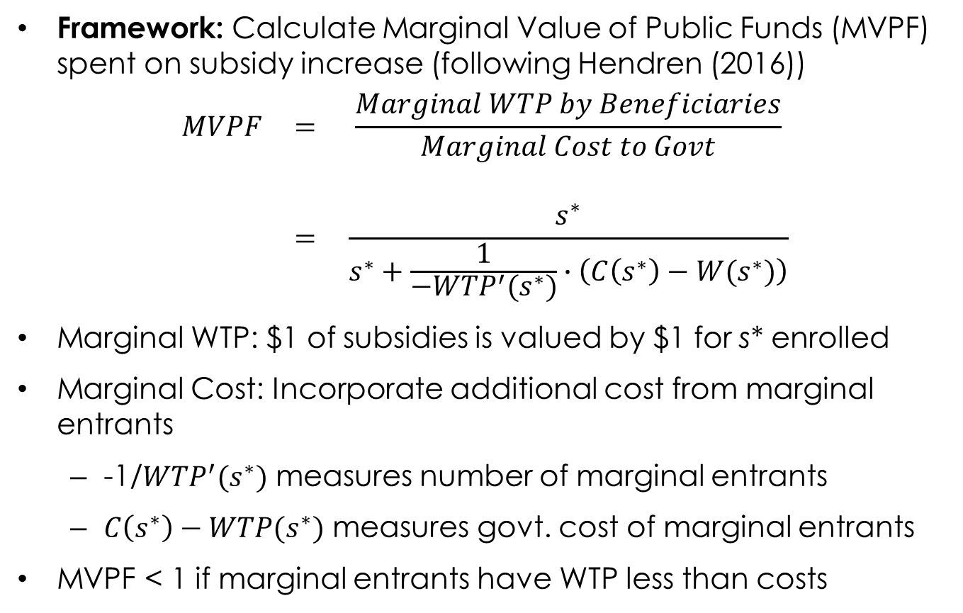
Implications for Redistribution
Framework: Calculate Marginal Value of Public Funds (MVPF) spent on subsidy increase (following Hendren (2016))
$$\begin{matrix}MVPF & = & \frac{Marginal WTP by Beneficiaries}{Marginal Cost to Govt} \\ & & \\ & = & \frac{s^{∗}}{s^{∗}+\frac{1}{−{WTP}^{′}(s^{∗})}∙\left(C\left(s^{∗}\right)−W(s^{∗})\right)}\end{matrix}$$
Marginal WTP: $1 of subsidies is valued by $1 for s* enrolled
Marginal Cost: Incorporate additional cost from marginal entrants
-1/${WTP}^{′}(s^{∗})$ measures number of marginal entrants
$C\left(s^{∗}\right)−WTP(s^{∗})$ measures govt. cost of marginal entrants
MVPF < 1 if marginal entrants have WTP less than costs

Slide 108
Marginal Value of Public Funds
Benefit-cost test: Does MVPF of policy exceed relevant threshold for counterfactual policy
MVPF > 1 if recipients willing to pay cost to government of additional subsidies (e.g. due to adverse selection)
Various possibilities for incidence of ↓ uncomp. care:
No value
Reduced govt costs
Low income – e.g. better care for remaining uninsured
High income – e.g. reduced private insurance premiums

Slide 109
MVPF of Expanded Subsidies
Uncompensated Care Incidence
Notes:
30% and 90% insured corresponds roughly to in sample range we observe.
MVPF<1 → indiviudals would prefer $1 lump sum transfer to $1 of insurance subsidies.
MVPF = 0.28 → recipients are willing to pay about 30 cents for every $1 increase in government spending on subsidies.

Slide 110
MVPF of Expanded Subsidies
Uncompensated Care Incidence
Notes:
Prior calculation implicity assumed uncompensated care was non existent or had zero social value.
Impact of accounting for uncompensated care depends on incidence:
On govt (if public funds used to reimburse hospitals for uncomp care) → decrease costs in denominator of MVPF
On low income beneficiaries (if redunctions in uncomp care costs for the newly insured allows providers to provide better care to those who remain uninsured) → add uncompensated care costs to nunmerator of MVPF for marginal enrollees

Slide 111
MVPF of Expanded Subsidies
Uncompensated Care Incidence
Notes:
Of course appropriate benchmark for the MVPF may not be 1. insurance subsidies to low income adults may serve redistributive aims, and redistribution inevitably involves some resource cost (Okun leaky bucket).
One benchmark: with a utilitarian swf, and the consumption level of eligible population relative to general population, and individual CRRA w rel risk aversion of 3, given eligible population has median consumption that is 60% of general MA population, suggests society would prefer policies with a MVPF of at least 0.2 (i.e. willing to burn 80 cents to get 20 cents into the low income adults).

Slide 112
MVPF of Expanded Subsidies
EITC Benchmark = 0.9
Uncompensated Care Incidence
Notes:
Alternative benchmark that doesn’t require us to take a stand on curvature of individual utility function or social welfare function is to compare the MVPF to other transfer programs.

Slide 113
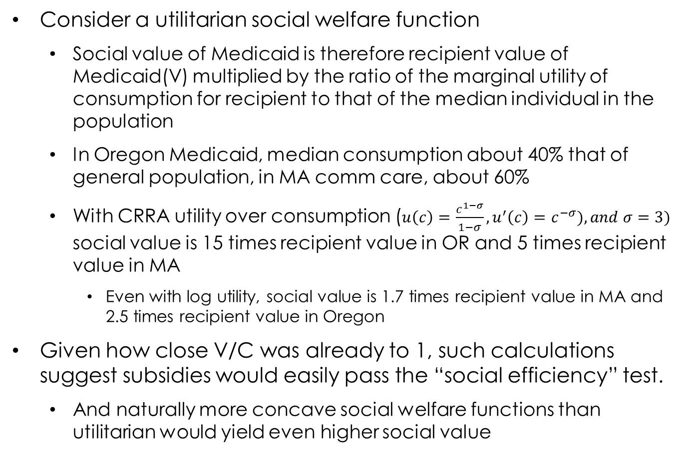
Social Cost-Benefit Analysis
Consider a utilitarian social welfare function
Social value of Medicaid is therefore recipient value of Medicaid(V) multiplied by the ratio of the marginal utility of consumption for recipient to that of the median individual in the population
In Oregon Medicaid, median consumption about 40% that of general population, in MA comm care, about 60%
With CRRA utility over consumption ($u\left(c\right)=\frac{c^{1−σ}}{1−σ},u^{′}\left(c\right)=c^{−σ}), and σ=3)$ social value is 15 times recipient value in OR and 5 times recipient value in MA
Even with log utility, social value is 1.7 times recipient value in MA and 2.5 times recipient value in Oregon
Given how close V/C was already to 1, such calculations suggest subsidies would easily pass the “social efficiency” test.
And naturally more concave social welfare functions than utilitarian would yield even higher social value
Medicaid: What Does It Do and What Does That Mean?

Slide 114
Comment: Recipient vs. Social Value- the Case of Depression
Medicaid reduces probability of depression by 9 percentage points
Worth ~ 0.03 quality-adjusted life years per Medicaid beneficiary(QALY)
A year in perfect health yields 1 QALY; a year in which one is dead yields 0 QALYs
This QALY benefit, multiplied by “standard” value of a statistical life year (VSLY) of $100,000 would imply $3,000 in value from depression reduction alone
Compared to gross cost of Medicaid of about $3,600
So how come ex-post approach is yielding such a low value of V compared to G?
Medicaid: What Does It Do and What Does That Mean?

Slide 115
Comment: Recipient vs. Social Value- the Case of Depression (con’t)
How come ex-post approach is yielding such a low value of V compared to G?
VSLY defined as (hypothetical) willingness to pay by recipient for a small change in the probability of death
Can’t apply VSLY for low income population – average consumption is 40 percent of the general population’s!
We scaled “consensus” VSLY for “typical” US individual by ratio of marginal utility of consumption of general population to the (much higher) marginal utility of consumption of the Oregon population
Note that moving from recipient value to social value for utilitarian SWF was precisely undoing this!
Social willingness to pay for a life year is higher for a lower income individual
Medicaid: What Does It Do and What Does That Mean?

Slide 116
Medicaid compared to alternative distributional tools?
Results suggested that Medicaid likely easily passes social cost-benefit test
V / C is already close to 1, and social value of a dollar to poor likely several times recipient value (simply through concavity of utility function, let alone any curvature on social welfare function
Passing the “social cost benefit test” seems necessary but not sufficient
Could we get same amount of distribution at lower cost?
In general cash considered more efficient to in-kind
But recall reasons why in-kind transfers can be more efficient
Medicaid: What Does It Do and What Does That Mean?

Slide 117
Comparison of Distributional Tools
How costly is distribution through Medicaid vs. Taxes
Compare welfare generated per dollar of expenditure under Medicaid (V/G ~0.2 to 0.5) to EITC
For EITC, given labor supply distortions, V/G ~0.9 (Hendren, 2016)
NB: For EITC, V is simple (cash is valued at a dollar) so only “work” is estimating labor supply distortions (push up G).
Medicaid: What Does It Do and What Does That Mean?

Slide 118
Ultimate Economic Incidence of “Non-Recipient” Benefits is Key
EITC: Generates about $0.90 of value per dollar of expenditures
Medicaid: generates $0.20 to $0.50 of value to recipient per dollar of expenditures and $0.60 of transfer
If ultimate economic incidence of transfers is all on low income individuals, looks about like EITC
(V + 0.6G)/G ~$0.8 to $1.1
If ultimately economic incidence is all on top of income distribution (CEO pay?), then looks more costly than EITC
Hendren (2014) estimates that can turn $ at top of income distribution into about $0.50 to bottom through modifications of tax schedule
Then (V + 0.3G)/G ~0.5-0.8
Medicaid: What Does It Do and What Does That Mean?

Slide 119
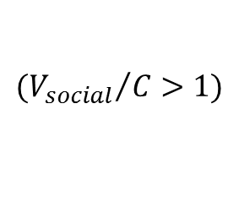
Implications: Recap
Value of Medicaid to recipients (V) substantially below Medicaid expenditures (G)
Efficiency case for Medicaid (V/C >1?) inconclusive
Distributional case for Medicaid
Social Value of Medicaid likely exceeds need cost given recipients’ high marginal utility of consumption
Other forms of distribution transfer more value per dollar of expenditures
E.g. EITC compared to Medicaid
Although if ultimate incidence of transfers to non-recipients is the low income, might be comparable to EITC
Medicaid: What Does It Do and What Does That Mean?

Slide 120
Implications: Other Considerations
Political Economy
Easier to generate political support for in-kind vs. cash transfers?
Society values “equal access to care”
Now moral hazard (increased care due to health insurance) is a benefit not a cost!
“Rights-based” notion
Society values “access to care” even if the low income individual prefers the cash?
“Non-individualist” social welfare function
Medicaid: What Does It Do and What Does That Mean?

Slide 121
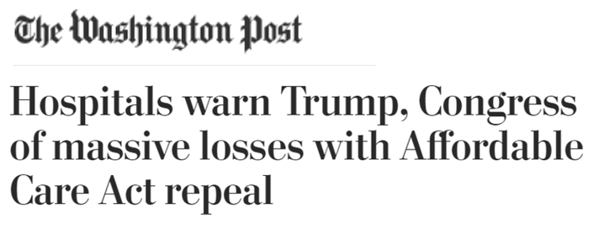
Who are The “Non-Recipient” Beneficiaries? Some Anecdotes
First hospital insurance in US (Blue Cross plans in 1930s) were designed to help patients and hospitals during Great Depression
“I could remember the difficulties we had then, trying to keep our doors open... People brought chickens in and meat to pay their bills. They would paint or do work around the hospital of some kind...” – Cunningham & Cunningham 1997
Hospitals have actively lobbied for state Medicaid expansions under ACA and against ACA repeal

Slide 122
Who are The “Non-Recipient” Beneficiaries? Some Evidence
(Easier) question: who pays for the uninsured’s care?
Ex ante charity care (non profit hospitals; public clinics)
Garthwaite, Gross and Notowidigdo (2016): each uninsured individual costs hospitals approximately $800
Ex post charity care: bad debt
Dobkin et al. (2016): each uninsured hospitalization generates approximately $6,000 in unpaid medical bills sent to collection
Public Sector may reimburse for some of this (e.g. DSH)
(Much harder) question: who bears ultimate economic incidence of this informal insurance?
Crucial for normative analysis of health insurance subsidies

Slide 123
Implications for health policy
Low-income “uninsured” have a lot of implicit insurance
This makes it hard to generate substantial take-up of even heavily subsidized formal health insurance
Implication I: Samaritan’s dilemma (Buchanan 1975; Coate 1995)
New testament parable of the Good Samaritan
Traveler attacked by robbers and left for dead by side of road. Samaritan traveling along sees him and takes care of him and revives him.
Morality tale about virtue of kindness to strangers
What’s the dilemma?

Slide 124
Samaritan’s dilemma
Samaritan’s dilemma I (Buchanan 1975; Coate 1995)
Moral society unwilling to let sick, poor people go unaided
Ex-post charity care reduces demand for insurance
Forgo insurance because know society will provide care ex-post
Why is this a problem / what is the inefficiency?
No reason to expect society to choose “the right” level of protection for the poor
Indeed presumably heterogeneity across individuals in optimal level
Free rider problem suggests level of charity likely sub-optimal from rich’s perspectives

Slide 125
General Problem: Crowd-out / no top-up
Could think of charity care as guaranteeing a basic level of care, that individuals can then top-up on margin
But in practice cannot do that.
If buy insurance (or care directly) have to pay all the inframarginal costs that would have been covered by charity
Inefficiency arises because WTP on margin for more of good may exceed cost but cannot purchase that without paying for inframarginal

Slide 126
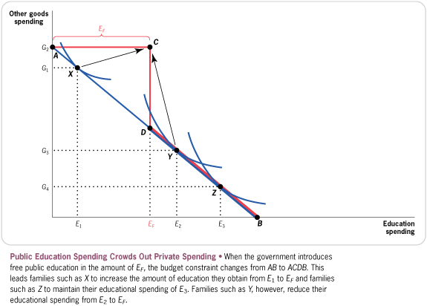
Public Education: Peltzman (1973)
Classic article on crowd-out

Slide 127
Crowd-out
Key is that cannot pay on margin for incremental amount of good
Cutler and Gruber (1996) “Does Public Insurance Crowd Out Private Insurance?”
Brown and Finkelstein (2008): Medicaid crowd out of LTC Ins.
Conceptual solution: allow “top up”
Can we replicate the informal contract with a formal one?
E.g. public sector covers emergency room and individuals can buy “top up” insurance

Slide 128
Implications for health policy
Low-income “uninsured” have a lot of implicit insurance
This makes it hard to generate substantial take-up of even heavily subsidized formal health insurance
Implication II: Potential distortion in provider location and investment
Dranove, Garthwaite, Ody (2015): “Floor and trade” proposal for charity care

Slide 129
Many open & important research questions
Samaritan’s dilemma has received too little empirical attention (relative to say, adverse selection!)
Descriptive: Nature and form of uncompensated care?
Empirical evidence: impact of available charity care on:
Demand for private health insurance?
Location and investment decisions of healthcare providers?
Efficiency of informal insurance vs. formal insurance?
Economic incidence of implicit insurance?

Slide 130
Summary: What Did We Find and What Does It Mean?
Medicaid benefits recipients: improves health, reduces out of pocket spending, lowers medical debt
Medicaid produces large transfers to non-recipients: About $.60 of every Medicaid dollar goes to providers of charity care for low income uninsured (e.g. hospitals)
Low-income “uninsured” in fact have implicit insurance
Value of a Medicaid to recipients: 20 to 50 cents per (gross) dollar of Medicaid spending
Medicaid as a way to redistribute to poor: Social Value exceeds net costs, but may deliver less bang for the buck than cash transfers like EITC

Slide 131
Complementarities Between Empirical Evidence and Economic Theory
Need empirical research design that yields credible causal estimates of impact of insurance
Randomized evaluations extremely valuable in this regard
Need economic theory to discipline interpretation of estimated impacts of Medicaid
Estimating value to recipients requires more assumptions (and therefore caveats) than estimating impacts
But formal analysis preferable to undisciplined assertions about value of estimated impacts
Medicaid: What Does It Do and What Does That Mean?
Notes:
Empirical evidence and economic theory are complements, not substitutes.
Two great tastes that taste great together.

Slide 132

Two Great Tastes That Taste Great Together
Medicaid: What Does It Do and What Does That Mean?

